Slide 1

EBC/GNG5125 – Data Science Applications - Summer 2021 Assignment 1 - Classification
Name | Email
Michael Khalil | mkhal120@uOttawa.ca
Gehad Abo Kamar | gabok033@uOttawa.ca
Khadija Taha | khesh072@uOttawa.ca
Youssef Metwally | ymetw027@uOttawa.ca

Slide 2
Agenda
Data Chosen.
Preprocessing and Cleaning Data.
Feature Engineering.
Model Building.
Model Evaluation.
Model Selection.
Error Analysis and Visualization.
Analysis of Bias and Variability.
Conclusions and Future Work.
References.

Slide 3
Data Chosen
we selected 5 books from gutenberg.
All 5 books from the same category (Crime).
Each book has its own author.
Crime and Punishment by Fyodor Dostoevsky.
Major Barbara by George Bernard Shaw.
Southern Horrors Lynch Law in All Its Phases by Ida B. Wells-Barnett.
Financial Crime and Corruption by Sam Vaknin.
A Love Crime by Paul Bourget.

Slide 4
Preprocessing and Cleansing Data
Split each book to 200 random partitions.
Each partition has 100 words.
Transform each char to lowercase.
Split sentences into words.
Remove stop-words and garbage characters.
Steaming words.
Label each partition with the author’s name.

Slide 5
Feature Engineering
Split the Data (partitions and author's names) into Training and Testing.
Apply transformations
Bow
TF-IDF
N-Gram
LDA
Word-Embedding

Slide 6
Model Building
Pipeline is a utility in Python Sklearn library that can be used to automate standard machine learning workflows.

Slide 7
Model Evaluation
Perform ten-fold
cross-validation.

Slide 8
Model Evaluation
Fine tune the champion model to optimize the result.
Parameters range:
tran2__use_idf: (True, False),
tran1__ngram_range: [(1, 1), (1, 2), (2,2)],
clf__alpha: (1e-2, 1e-3)
Best parameters:
tran2__use_idf: True
tran1__ngram_range: (1, 1)
clf__alpha: 0.01

Slide 9
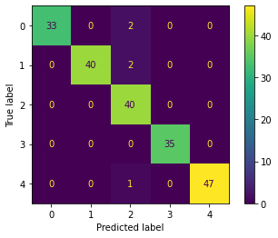
Error Analysis
Testing the model
Precision: 96.5%

Slide 10
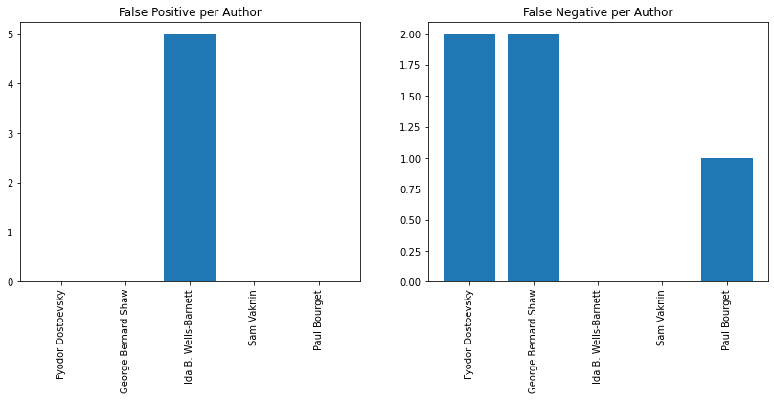
Error per Author

Slide 11
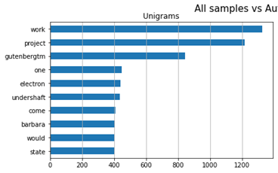
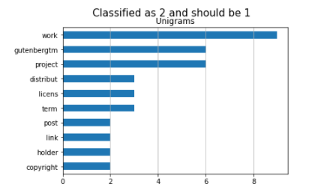
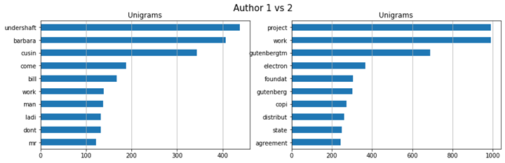

Slide 12
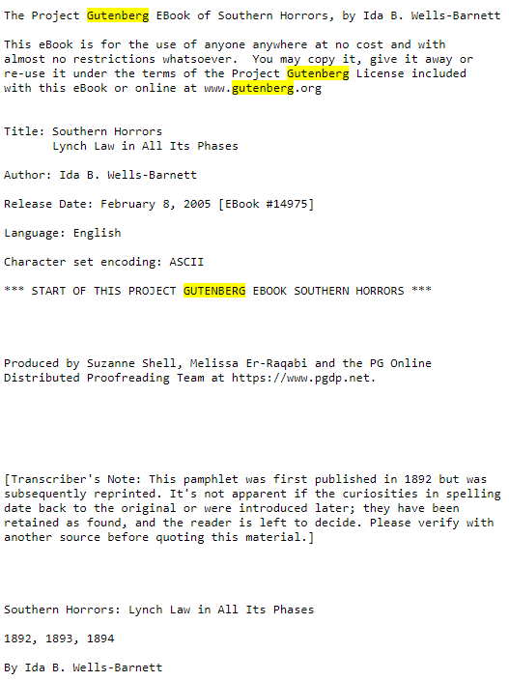
A Cause of Error

Slide 13
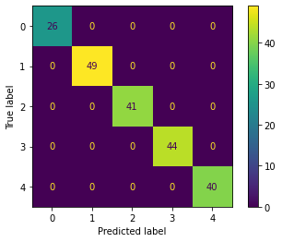
Error Analysis
Testing the treated model
Precision: 100%

Slide 14
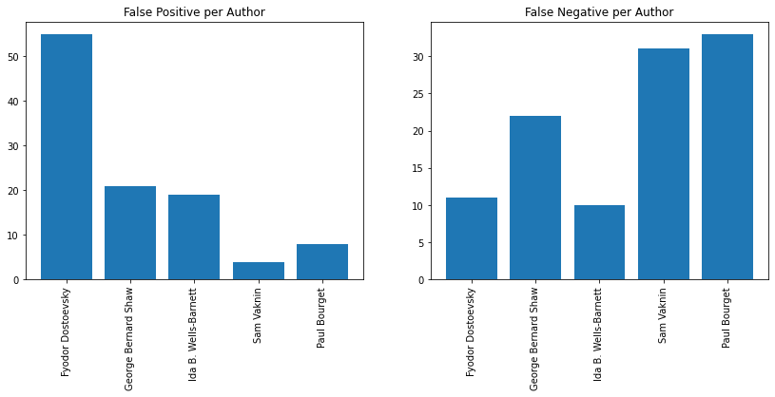
Verification

Slide 15
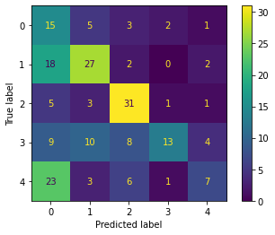
Verification
Bias: 0.715
Variance: 0.372

Slide 16
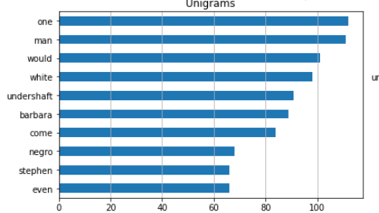
Verification
The most frequent words in all samples.

Slide 17
Future Work
More Cleanse
Increase Data size

Slide 18
Thank You !

